Slide 1



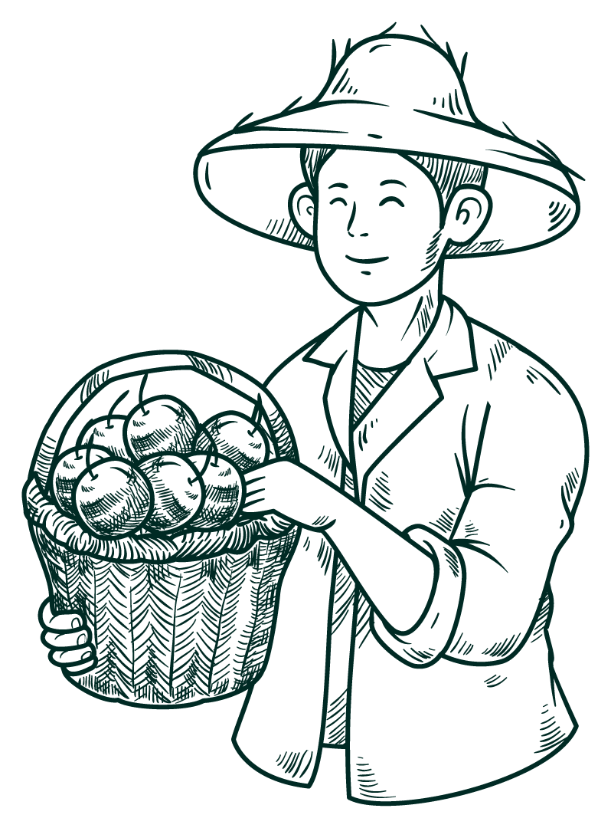

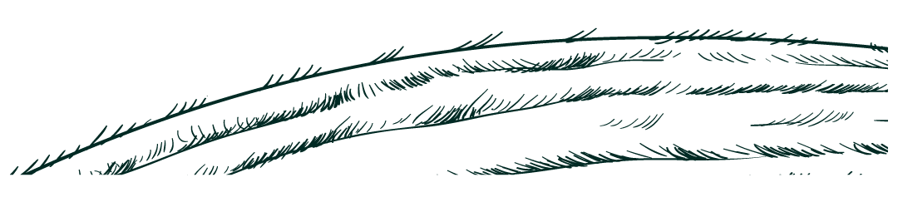
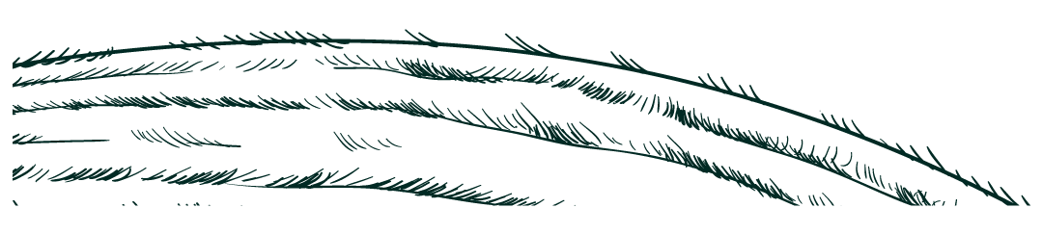
CHASHBASH.COM DIGITAL FARMING
কৃষি কাজ হবে এখন , আধুনিক

Slide 2


Table of contents
01
02
03
04
OUR TEAM
ABOUT CHASHBASH
AS-IS , TO-BE
ERD
05
06
SCHEMA
NORMALIZATION

Slide 3

TEAM MEMBERS
Let’s Discuss About Our Project’s Team Member
2030036 | FEROZ MAHMUD
2220058 | MARIA ASHRAFY
2110392 | ANNA PAUL TOMA
2130395 | SUMAIYA HOSSAIN ONIKA
2110855 | MD ARAFAT E NUR SOJIB (W)
2020058 | MD RAQUIBUL HASAN

Slide 4
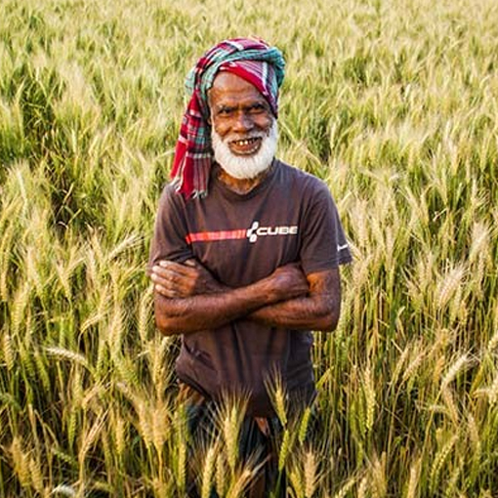
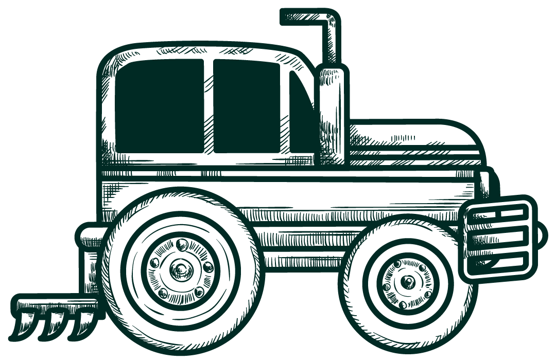
ABOUT CHASHBASH.COM
Chashbash.com is an Agri-Tech web application, designed to revolutionize the management and analysis of agricultural demand and supply. The platform gives farmers, warehouse managers, food safety officers, and other stakeholders the tools they need to keep an eye on production numbers, keep track of inventory, and effectively handle logistics. It has tools for evaluating manufacturing and supply chain performance, dynamic dashboards that provide insights into market price patterns, and real-time and historical data visualization. Chashbash.com tackles major challenges in agriculture, like supply chain inefficiencies and market volatility, by promoting smooth communication and providing useful insights. Better results for the ecosystem are ensured by the platform’s ability to empower stakeholders to make knowledgeable decisions, cut waste, and support sustainable agricultural practices.

Slide 5
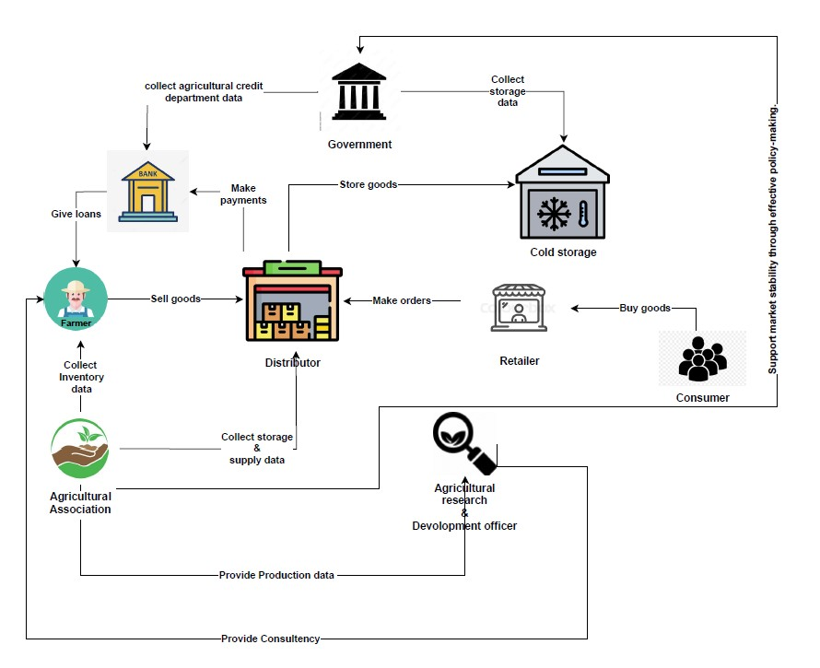
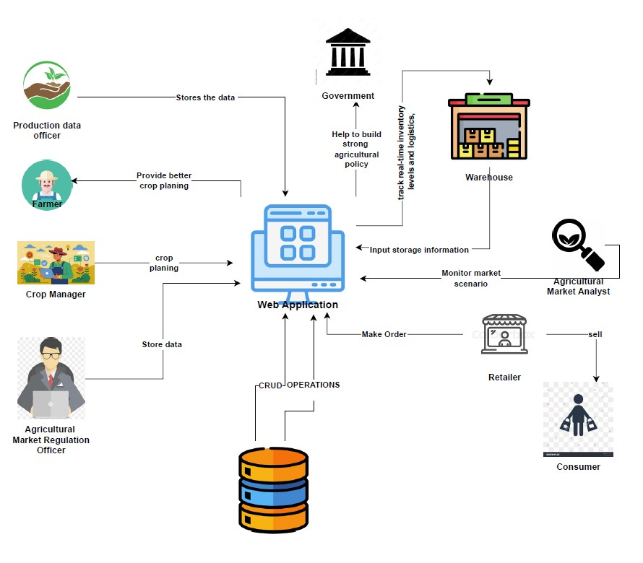

RICH PICTURE
AS-IS
To-BE

Slide 6
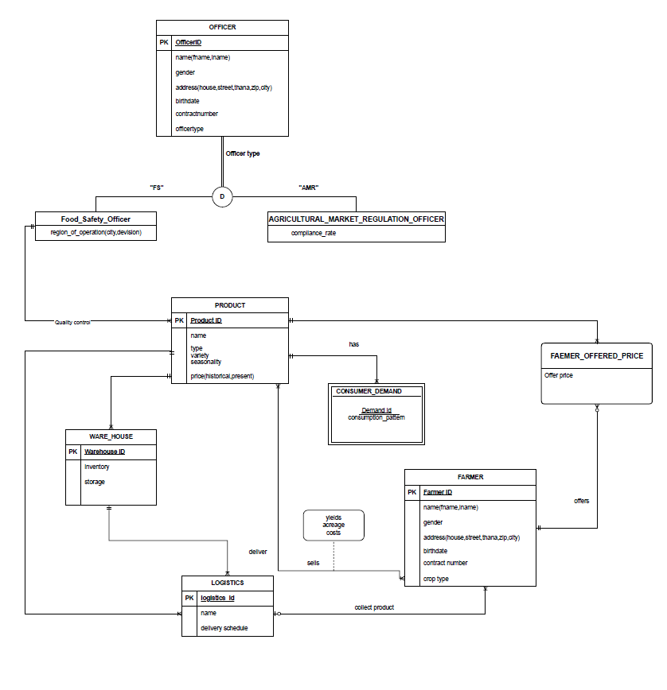
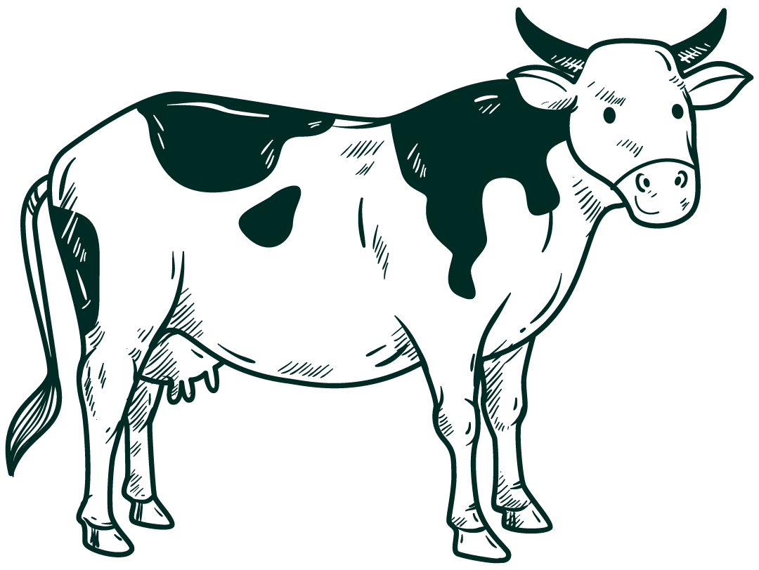
ERD

Slide 7
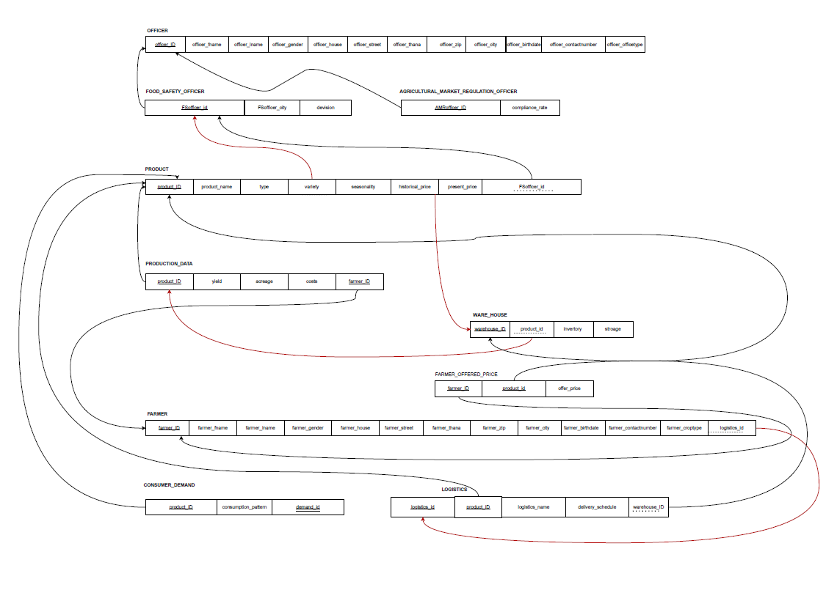

NORMALIZED SCHEMA
The relational schema provided above is already in normalized form as it complies with the normalization
1NF: The schema needs to be set up so that there are no repeated groups and a primary key for every
2NF:No non-key attribute in the schema may depend entirely on the composite main key.
3NF: There cannot be any transitive dependencies in the schema.
BCNF: A non-key in the schema cannot identify a candidate key or a portion of it.
Our schema complies with all the normalization protocols mentioned above.

Slide 8
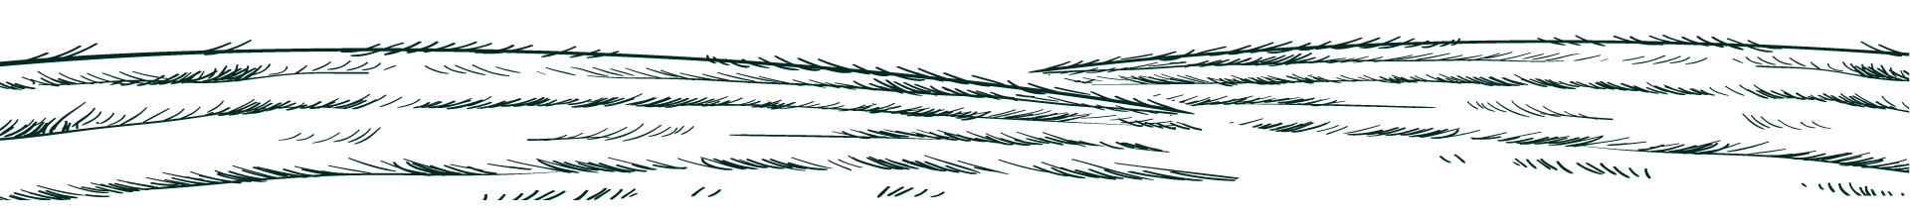
PROBLEM ?
FACED :
During the development of this project ,we had several challenges that required our flexibility and perseverance. One of the primary issues was the need to constantly update and improve the entity-relationship diagram (ERD), database schema, rich picture to be, and in order to meet changing project objectives. This approach needed a lot of testing and careful attention to detail to ensure that everything was accurate and consistent. Setting up XAMPP and establishing a reliable connection between the database and the platform were among the technical issues we encountered. It requires time and effort to configure the server, resolve compatibility issues, and ensure smooth database interactions. Additionally, database integration was difficult since we needed to regulate the flow of data between different parts of the system and ensure that data
SOLUTION :
To overcome this challenges, we used an iterative strategy to update the entity-relationship diagram (ERD), schema, and rich picture to be in order to solve project problems. Regular reviews ensured alignment with project requirements. In order to create a reliable environment, we consulted instructions for XAMPP setup and database connection problems and made necessary configuration adjustments. Issues with database integration were fixed via thorough testing, guaranteeing accurate and seamless data flow. Through feedback and usability testing, we enhanced the user interface to make it more user-friendly and accessible for farmers. We debugged and refined data for accurate visual representation using tools like Chart.js to handle chart-related difficulties. Git for version control improved collaboration, and effective problem-solving and time optimization were made possible by effective task management and teamwork.

Slide 9
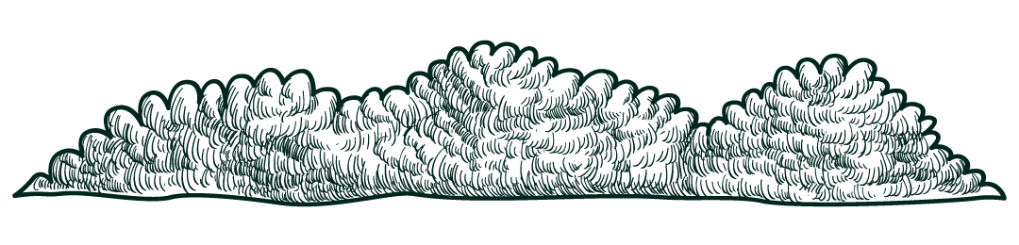
ThankS !
Finally , We Did it ☺

